Slide 1
Supercharge your ESXi deployment with PowerCLI

Slide 2
PowerShell Modules
Why Use PowerShell?
PowerCLI Intro
Demos!
Deep Dive Content Resources
Q & A

Slide 3

Supercharge your ESXi deployment with PowerCLI
Andy Syrewicze
Microsoft MVP
Andy is a Technical Evangelist for Altaro Software.
12+ years Experience providing technology solutions across several industry verticals including, education, fortune 500 manufacturing, healthcare and professional services working for MSPs and Internal IT Departments.
During that time - expert in VMware, Linux, and Network Security.
Last 7 years: Virtualization, Cloud Services and the Microsoft Server Stack, with an emphasis on Hyper-V.
Blog: http://www.altaro.com/vmware and http://www.altaro.com/hyper-v Twitter: @asyrewicze

Slide 4

Supercharge your ESXi deployment with PowerCLI
Adam Bertram
PS> WhoAmi
Pluralsight Author
PowerShell Trainer
Freelance Writer
PowerShell Consultant
Microsoft MVP
Blog: http://adamtheautomator.com Twitter: @adbertram

Slide 5

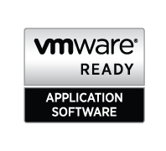
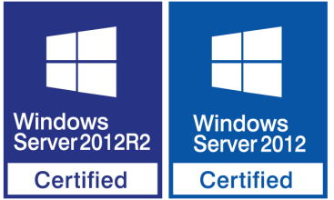
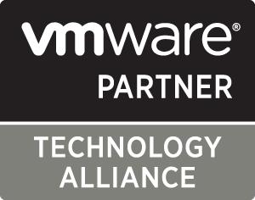

Supercharge your ESXi deployment with PowerCLI
About Altaro Software
Altaro is a fast-growing developer of easy to use and affordable backup solutions for small- to medium-sized businesses, specializing in backup for virtualized environments.
Virtual Backup trusted by 30,000+ SMBs
Flagship product: Altaro VM Backup
altaro.com/vm-backup

Slide 6
Supercharge your ESXi deployment with PowerCLI
PowerShell Modules
Groupings of like functions
Shareable “packages” of functions
Vendor-supported management
Functions built to interact with APIs
Notes:
If you've been writing PowerShell scripts for awhile now you've seen just how much time you can save automating stuff. However, you might not have gotten to the point of understanding modules. Since PowerCLI is a set of modules which you'll be interacting with, I thought it'd be a good idea to give a brief refresher on the topic. At it's simplest, a module is simply a grouping of like PowerShell functions. It's a way of grouping a bunch of functions together, in this case vSphere functions, which allows for easy sharing with others. A lot of vendors provide PowerShell modules to manage their products for this reason. Thankfully, it's very easy to use modules in PowerShell. Simply place a file PSM1 file where PowerShell is looking and it's automatically imported into your session. At that point, you can use all of the functions that module has to offer. Even though module functions don't have to talk to APIs, most do when provided by a vendor like VMware. vSphere has APIs that expose nearly all of the functionality you do in the GUI via a programmatic interface. This means when you type New-VM, for example, PowerShell goes out, makes a call to an API in vSphere and vSphere converts those instructions to get a VM provisioned. It's simply another interface to the product like like the GUI is.

Slide 7
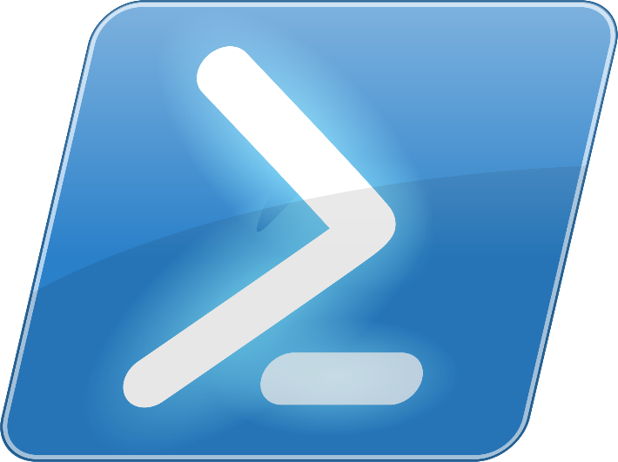
Supercharge your ESXi deployment with PowerCLI
Why Use PowerShell?
Hint: Because it’s awesome.
GUIs don't scale
PowerShell is an automation toolset
Tool-making
Wide industry support
Automation glue
Notes:
So, why use PowerShell to manage vSphere at all? You might be thinking, "I can do everything in the GUI, why do I need to learn this PowerCLI thing and fiddle with text?". Well, the answer is most importantly, GUIs don't scale well. I'm sure there's been times when you need to orchestrate some process like bringing up a set of VMs, maybe installing VMware tools on them, shutting a bunch down, creating some disks...whatever.
The point is doing all of that would take a ton of mouse-clicking which would take time. Plus, if you do it via the GUI, you haven't really saved your work. You'll have to do that exact same thing again. By using PowerCLI, you can build tools which you can reuse over and over again so you don't have to repeat yourself and, if you build them right, you can use them as building blocks to build more advanced tools as you go along.
Another thing to take into consideration is the wide industry support that PowerShell has. As I mentioned earlier, lots of vendors; not just VMware are releasing modules to manage their products. If you do more things in PowerShell, you can start to build these really cool tools that marry multiple products together like pulling information from a database, injecting that into vSphere somewhere or dynamically pulling out VMs from all your hosts and inserting attributes into Active Directory.
PowerShell is like the glue that can bind all of these disparate technologies together. It's a single tool with hooks into just about anything which allows you to build custom tools to automate your entire IT infrastructure.

Slide 8
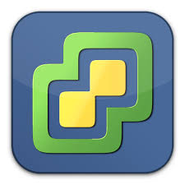
Supercharge your ESXi deployment with PowerCLI
vSphere's PowerShell Support
PowerCLI
A set of PowerShell modules to interact with ESXi APIs
Not dependent on GUI changes
> 400 cmdlets to interact with vSphere
It's free!
Notes:
Now that you're just going to start managing your entire infrastructure in PowerShell..and you are....right? OK, good. Anyway, let's briefly go over what the PowerCLI can do for you before we get into the demo in a second.
First of all, the PowerCLI is a set of PowerShell modules that, as I mentioned before, interact with the ESXi APIs. You *could* do this yourself without PowerCLI but you'd probably have to be a software developer. The cmdlets that come with the PowerCLI allow us administrators to manage vSphere programstically without having to really learn what an API is or how it works. It's just how the cmdlets are talking to the hosts to make stuff happen.
Next, the PowerCLI is not dependent on GUI changes. I'm sure you've had that time in the past to where you're used to doing something in the GUI one way, upgrade and then it's either gone or in some completely different place making you wonder if the developers were on acid or something.
If you're using the PowerCLI to manage your virtual infrastructure, you don't have to worry about that stuff. Since you're using an entirely different interface all together, you aren't affected by that. Even if the developers change something with a PowerCLI cmdlet, you could even build your own proxy functions that mimic what you're used to. You aren't bound by an interface at this point.
..and did I mention it's completely free? No need to purchase a license or pay out the butt for a tool like this. VMware gives it to you free of charge not probably because they want to be nice but because it makes working with their product so much easier which might make you think how great vSphere is.

Slide 9
Supercharge your ESXi deployment with PowerCLI
Demo Prerequisites
PowerCLI 6.3
PowerShell v2+
ESXi 4.1+
vCenter Server 4.1+
Notes:
Before we get to the demo, let me set a few prerequisites here so you don't get mad at me when what I'm showing you doesn't work.
First, I'll be using PowerCLI 6.3. This is the latest version available right now and, since it's free, if you're on an old version, just do yourself a favor and upgrade now. I'd especially recommend this if you're still pre v6 as they moved all the functionality over to modules at that point from the older snapin technology.
I'll be on PowerShell v5 but you don't have to. PowerCLI will work on v2 and later but I *highly* encourage you to upgrade if you haven't already.
Next, you need to ensure your hosts are at least 4.1 or greater. If not, you're doomed to be using the GUI for the rest of your career.
Finally, you'll need vCenter Server 4.1 or greater.
OK, now that we've got the obligatory slide deck out of the way, let's jump into the demo and see what PowerShell and PowerCLI can do!

Slide 10
Supercharge your ESXi deployment with PowerCLI
Demo Overview
Setting the execution policy
Exploring the available commands
Connecting to vCenter
Using the pipeline
Building a small VM uptime tool
Notes:
OK, enough of the jibber jabber. It’s time for the demos!
Our first demo will be done by yours truly. In this demo, I’m going to go over how to get started with PowerCLI. Perhaps you haven’t even used PowerShell that much and PowerCLI is brand new to you. You’re going to get a lot out of this demo. As you can see, I’ll first be covering some PowerShell basics like setting the execution policy so we can run scripts and I’ll poke around a little bit with the available commands to show you how to get around in the PowerCLI.
Then, I’ll show you how to connect to the vCenter server. This will always be your first task when working with PowerCLI.
I’ll then show you how we can use PowerShell’s pipeline ability to pass around VM objects to do a few things. Finally we’ll package all of that knowledge up and build a small tool to easily find the total uptime for all of your VMs on a host.

Slide 11
Supercharge your ESXi deployment with PowerCLI
Where to Learn More
Cmdlet reference
http://bit.ly/cmdlet-ref
User guide
http://bit.ly/powercli-UG
PowerCLI community
http://bit.ly/powercli-community
VMware PowerCLI labs
http://bit.ly/powercli-labs
Notes:
I hope that you enjoyed the demos. Since we didn't have time to get into near everything PowerCLI had to offer, I've provided a few resources here where you can go for further information.
The first two there are online representations of the cmdlet reference and user guide. Although those are included when you install PowerCLI, I sometimes like looking at the web to get what I need to learn.
Next, since PowerCLI has been around for such a long time, the community is quite large. Head on over to the PowerCLI forums where you'll find lots of experts there to help you with just about any issue you might have.
And finally, is the PowerCLI labs. This is an awesome way to learn more about PowerCLI. They provide you with a virtual environment prebuilt and ready to go so you don't have to setup your own test environment. I'd highly encourage you to go this route before poking around in production.

Slide 12



Supercharge your ESXi deployment with PowerCLI
Altaro VM Backup
Virtual backup trusted by 30,000+ SMBs and 4,600+ IT Resellers and MSPs
Easy to use and deploy
Highly capable, unbeatable value
All the tools needed for solid VMware & Hyper-V backup strategy
Honest price and simple pricing structure
Advanced functionality - Offsite replication, Exchange item-level restore, PowerShell API, etc.
Scales – Central (and Remote) management capabilities for larger environments
Outstanding Support
High standard of product support
Premium support offered as part of the package – VMware and Hyper-V experts

Slide 13



Supercharge your ESXi deployment with PowerCLI
Altaro VM Backup
IT Reseller?
Join the Altaro Partner program!
Free to sign up
Free Partner training & certification
0 Commitment
Attractive discounts
Also available for MSPs!
For more info:
Visit altaro.com/partners
Email: sales@altaro.com

Slide 14
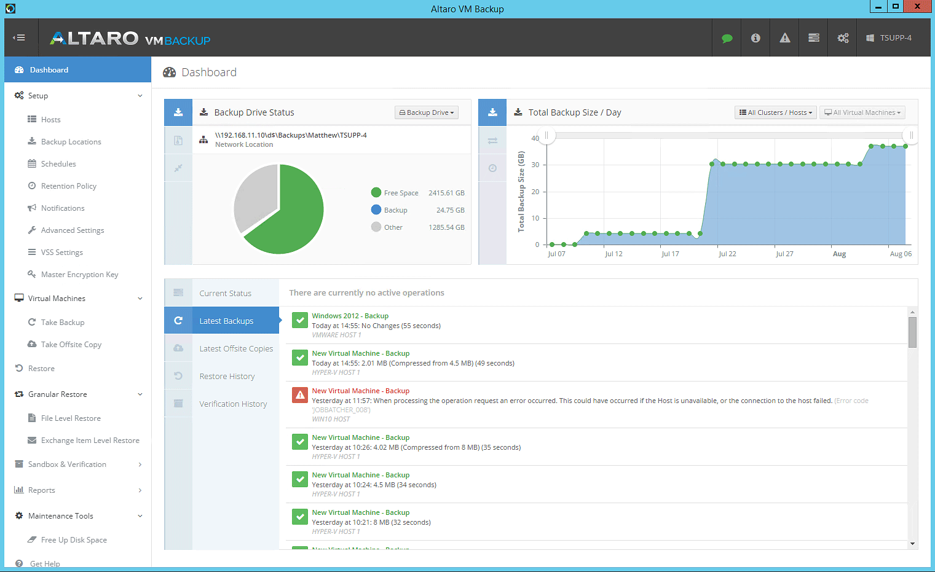
Supercharge your ESXi deployment with PowerCLI
Altaro VM Backup
Download your copy here: altaro.com/download (30-Day trial OR Free for 2 VMs, forever)

Slide 15
Questions?

Slide 16
Thank you for Attending!

